Slide 1




MS Support Services Pvt. Ltd.
FA C I L I T Y M A N A G E M E N T
S K I L L D E V E LO P M E N T & CO R P O R AT E T R A I N I N G M A N A G E M E N T H U M A N R ES O U RC E S E RV I C E S
S EC U R I T Y S E RV I C ES
T R A N S P O RT A N D F L E E T M A N A G E M E N T

Slide 2

Background
M3S is an assembly of seasoned Infrastructure Management, Facility Management, Human Resource Services, Security Services and Transport & Fleet Management professionals.
An ISO 9001:2015, ISO 14001:2015, ISO 45001:2018 M3S has been providing quality services to
Government Organization & Multinational Facilities across India.
M3S has a proven track record of Retaining existing client base by providing services of the International Standards.
The services provided by M3S are customized to complement the client’s strategic objectives and are delivered by trained and experienced professionals to achieve high quality results that are stable and cost effective.
Tie Ups with leading Vendors for supplies of International Standard Machinery and Chemicals.

Slide 3
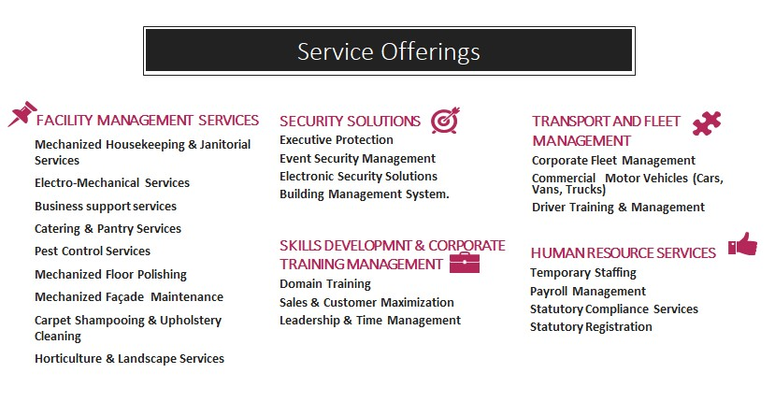

Slide 4
Highlights
100% Statutory Compliance Record
Zero Legal Cases
Non – Unionized work force
High Client Retention Rate
100% salaries imparted through bank transfers
Existing number of Employees on Company Payroll – 2600
Existing number of vehicles operating across India – 250
PAN India Presence
Direct Control – No Tertiary or Secondary Outsourcing
In-house manpower training programs to ensure that competent manpower is provided to the Client

Slide 5
Our Strengths & DNA
STRENGTHS
DNA
ISO 9001:2015, ISO 14001:2015, ISO
45001:2018
Trained & Captive Manpower- Through Skilling
India Project
Ability to scale
Execution process
Focus on Quality
Risk Assessment Framework
Business Continuity Plan
Innovation
Adaptability
Direct Control – No Tertiary or Secondary Outsourcing
Pan India Presence (Including Tier II, Tier III
Non – Unionized work force
Highest Response Levels in the industry
Zero legal cases
cities)

Slide 6
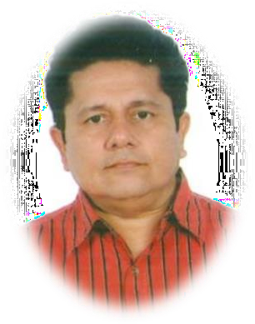
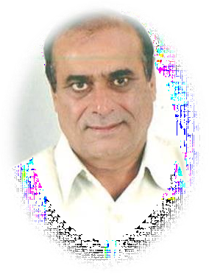
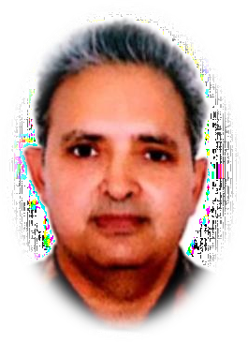
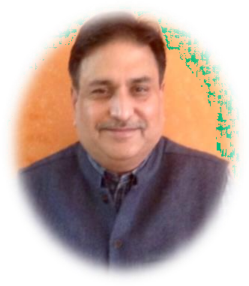
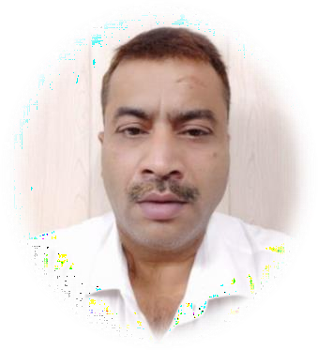
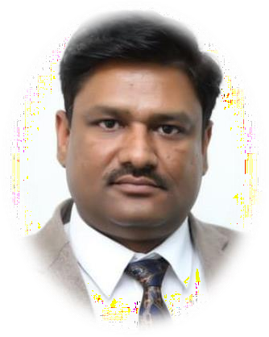
Core Team Competency
Anil Soni
Director
Rashter Kumar Dahiya Director
Sanjiv Vats
Promoter
Sanjay Rajvanshi
CEO
Dharmendra Sethi
President
Manoj Chauhan
Vice President
Our Core Team led by Mr. Anil Soni has vast experience in the field of Facility Mangament, Manpower Provison and othe related services for the Government as well as Private Client.

Slide 7
Leadership Team
Mr. Anil Soni - Director
Anil has a graduate degree in BSc (Non-medical), Diplomas/Masters in Computer Science, Marketing Management & Public Administration and an MBA degree in Business Strategy. He has a an experience of 31 years in Maneuvering Strategic Business Planning, Managing Investor Relations, Formulating & Implementing Systems and Procedures, Budgeting and Customer Relationship Management. His last assignment was with Premier Shield Pvt. Ltd as the Chief Executive Officer (CEO) and prior to that he was associated with A2Z Infra services Ltd in the capacity of Joint Managing Director (JMD) where he transformed a 6 Cr company to 300 Cr Company within 7 years.
Mr. Rashter Kumar Dahiya - Director
A decorated ex-serviceman, served in the Indian Army resides in Gurugram, Haryana. Now, Director with MS Support Services Pvt. Ltd. has prior experience in the same level with various firms involved with businesses related to construction, property management and much engagement into social work and certain NGO’s.
Mr. Sanjiv Vats - Promoter
Sanjiv is a Hotel Management graduate and has a total work experience of 20 years in the Services Industry. Sanjiv has worked with the best names in the hospitality industry like Hyatt Regency- India, Hyatt Cologne - Germany and organizations like American Embassy-Tokyo, Phantasy island - Germany etc. His domestic and international experience has enabled him to develop a strong understanding for client needs and providing services that tailor-made to meet the client’s requirements.

Slide 8
Leadership Team
Mr. Sanjay Rajvanshi - CEO
32+ years of total corporate experience, in Sales & Marketing and Training, out of which 15 years of training delivery and development experience at different levels. This experience has been in diverse industries and selling environments. Along with this diversity of experience, also brings rich experience of training and consulting assignments in the field of Sales and Training & Consulting. He has worked with organizations like Apollo Tyres Ltd and NIS Sparta Ltd, and is a certified trainer for programs impacting both behavior and business aspects of Individual Performance, through programs like Performance Management Solutions.
Mr. Dharmendra Sethi –President
An astute, results-oriented leader with proven success record. 20 years of experience in Business development, CRM, Prime accounts management, overseeing operations, conceptualization, setting up and strategic management of Profit Centers. A proactive Planner with expertise in strategic planning, market plan execution, competitor and market analysis. A complete team man and a powerful trainer. Ability to swiftly ramp up projects with cross-functional skills. An effective Communicator with exceptional presentation skills and abilities in forging business partnerships, lead cross-cultural teams and establish beneficial relationships with key players in the industry.
Mr. Manoj Chauhan – Vice President
Manoj has a Masters degree specializing in Marketing. He is having experience of 18+ Years in Marketing, Operations, liasioning and business development. He was Associated with A2Z Infra Services Ltd for 18 years starting from 2002 to 2020 as a Vice president, he was handling Business Development and Operations of premium government projects like Indians railways
,Metros and other projects. Presently He heads our Railways vertical.

Slide 9

Our Major Gains
DMRC Line 8
  No. of Manpower
  Contract Period
  Locations Covered
  Services
27.87 CR
330
4 Years
8 Stations
Housekeeping
Central Railway-Akola
  No. of Manpower
  Contract Period
  Locations Covered
  Services
03.09 CR
55
3 Years
Akola Station Housekeeping
South Railway-Chennai
  No. of Manpower
  Contract Period
  Locations Covered
  Services
02.26 CR
55
1 Year
Akola Station Housekeeping
DMRC Line 5
  No. of Manpower
  Contract Period
  Locations Covered
  Services
13.27 CR
175
4 Years
7 Stations Housekeeping
Central Railway-Jalgaon 03.14 CR
NE Railway Katihar
  No. of Manpower
  Contract Period
  Locations Covered
  Services
04.55 CR
131
2 Years
Katihar Station Housekeeping
No. of Manpower
Contract Period
Locations Covered
Services
55
3 Years
Jalgaon Station Housekeeping
Skills Jharkhand
  No. of Manpower
  Contract Period
  Locations Covered
  Services
06.05 CR
700
Year
Districts
Central Railway-Khandwa 03.34 CR
Eastern Railway-Ranchi
  No. of Manpower
  Contract Period
  Locations Covered
  Services
09.25 CR
176
3 Years
Ranchi Station
Housekeeping
No. of Manpower
Contract Period
Locations Covered
Services
55
3 Years
Khandwa Station
Housekeeping
Skill Development

Slide 10
Our Major Gains
DMRC Line 3
  No. of Manpower
  Contract Period
  Locations Covered
  Services
31.89 CR
201
4 Years
12 Stations
Housekeeping
Central Railway-NAGPUR
  No. of Manpower
  Contract Period
  Locations Covered
  Services
19.49 CR
167
2Years
NAGPUR & AJNI
Housekeeping
DMRC Line 2
  No. of Manpower
  Contract Period
  Locations Covered
  Services
46.90 CR
306
4 Years
14 Stations Housekeeping
AAI- Kushinagar
  No. of Manpower
  Contract Period
  Locations Covered
  Services
1.10 CR
15
3Years
Kushinagar Airport Housekeeping
DMRC Line 8
  No. of Manpower
  Contract Period
  Locations Covered
  Services
27.34 CR
176
4 Years
9 Stations Housekeeping

Slide 11
Our Financial of Last 5 Years

Slide 12









Our Pride Our Client…

Slide 13













Our Pride Our Client…(Cont.)

Slide 14
MAJOR CLIENT
FACILITY SERVICES | MANPOWER OUTSOURCING SERVICES | FLEET MANAGEMENT | SKILL DEVELOPMENT
1. ENGINEERS INDIA LTD. | 1. ESIC (GURGAON) | 1. ERICSSON INDIA PVT. LTD | 1. DDUGKY- Jharkhand
2. DELHI METRO RAIL CORPORATION LTD. | 2. FORTIS HOSPITAL (NOIDA) | 2. ALCATEL LUCENT INDIA LIMITED | 2. DDUGKY- Tripura
3. JMD MAINTENANCE LTD. | 3. NTT DATA GLOBAL DELIVERY SERVICES LTD. | 3. NATIONAL CAPITAL REGION TRANSPORT CORPORATION LTD | 3. DDUGKY- Uttar Pradesh
4. SITI NETWORK LTD. | 4. ARICENT TECHNOLOGY LTD. | 4. NOKIA SOLUTIONS AND NETWORKS INDIA PRIVATE LIMITED
5. INTELNET GLOBAL SERVICES PVT. LTD. | 5. DELHI METRO RAIL CORPORATION LTD. | 5. NTT DATA GLOBAL DELIVERY SERVICES PRIVATE LIMITED
6. LITE BITE FOODS PVT. LTD. | 6. INDIAN RAILWAYS | 6. TATA COMMUNICATIONS
7.INDIAN RAILWAYS | 7. RAMBOLL INDIA PVT. LTD.
8. ALCATEL LUCENT INDIA LTD. | 8. AAI KUSHINAGAR

Slide 15
Service Offerings
FACILITY MANAGEMENT SERVICES
  MECHANISED HOUSEKEEPING & JANITORIAL SERVICES
  ELECTRO-MECHANICAL SERVICES
  BUSINESS SUPPORT SERVICES
  CATERING & PANTRY SERVICES
  PEST CONTROL SERVICES
  MECHANISED FLOOR POLISHING
  MECHANISED FAÇADE MAINTENANCE
  CARPET SHAMPOOING & UPHOLSTERY CLEANING
  HORTICULTURE & LANDSCAPE SERVICES
SECURITY SOLUTIONS
  EXECUTIVE PROTECTION
  EVENT SECURITY MANAGEMENT
  ELECTRONIC SECURITY SOLUTIONS
  BUILDING MANAGEMENT SYSTEM

Slide 16
Service Offerings (Contd.)
TRANSPORT AND FLEET MANAGEMENT
  CORPORATE FLEET MANAGEMENT
  COMMERCIALMOTOR VEHICLES (CARS, VANS, TRUCKS)
  DRIVER TRAINING & MANAGEMENT
HUMAN RESOURCE SERVICES
  TEMPORARY STAFFING
  PAYROLL MANAGEMENT
  STATUTORY COMPLIANCE SERVICES
  STATUTORY REGISTRATIONS

Slide 17
Service Offerings (Contd.)
SKILLS DEVELOPMNT & CORPORATE TRAINING MANAGEMENT
  DOMAIN TRAINING
  SALES & CUSTOMER MAXIMIZATION
  LEADERSHIP & TIME MANAGEMENT
    CLASS ROOM TRAINING
    INSTRUCTOR LEAD TRAINING
    EXPERINTIAL TRAINING
    ON THE JOB MENTORING & COACHING

Slide 18
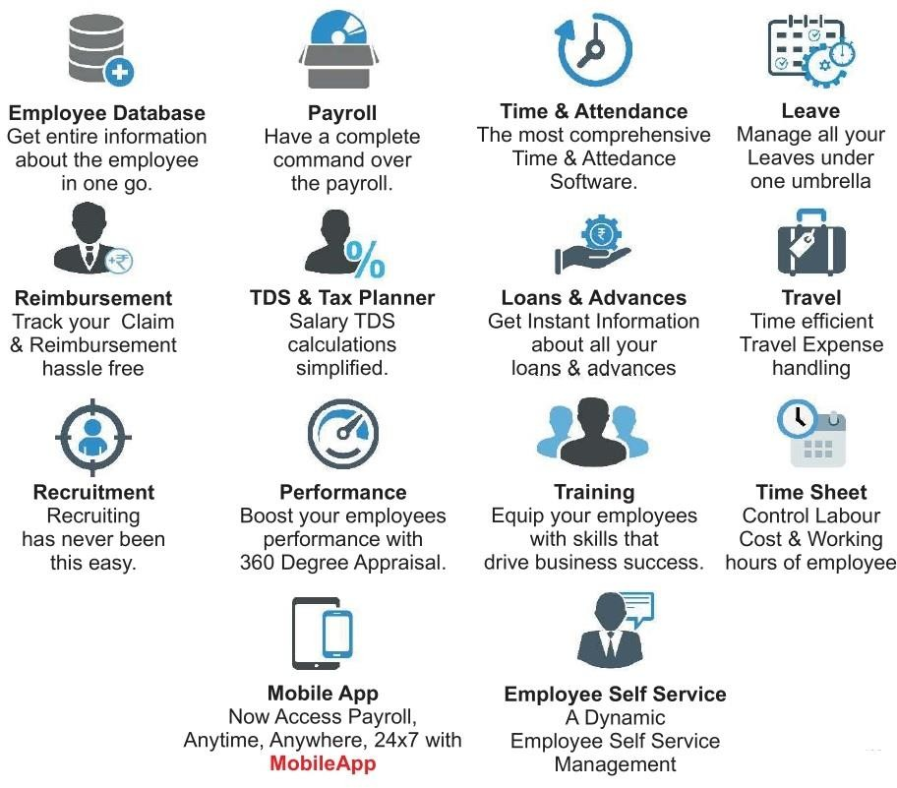
Our HR Practices

Slide 19
Escalation Matrix
Crack Team
Timely Deployments
Customized SOPs
Manager (Operations)
Team Leader
Supervisor Executive

Slide 20
Skill Development
M3S has been sanctioned 3 DDU-GKY Projects in the following states:
Jharkhand – 700 Trained Manpower Target (Govt. of Jharkhand)
Our training center is located at Bokaro, Jharkhand having training capacity of 100 candidates.
Tripura – 500 Trained Manpower Target (Govt. of Tripura)
Our training center is located at Bamnoli, Delhi having training capacity of 105 candidates.
Uttar Pradesh – 700 Trained Manpower Target (Govt. of Uttar Pradesh)
Our training center is located at Greater Noida, Uttar Pradesh having training capacity of 140 candidates.
Candidates trained in Facility Management & Housekeeping under NSQF Certified Course Curriculum.
Well-trained Manpower ready to be deployed at any of the sites.
Fair knowledge of English, IT & Soft Skills.

Slide 21
Value Added through Skill Development
The following will be the advantages of Skill Development :
Trained manpower as per the client requirement
Skillful workers on demand
Always availability of candidates in pipeline
Three (3) months PF contribution will be borne by Government itself for new employee (who
never worked before).

Slide 22


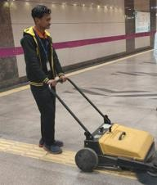
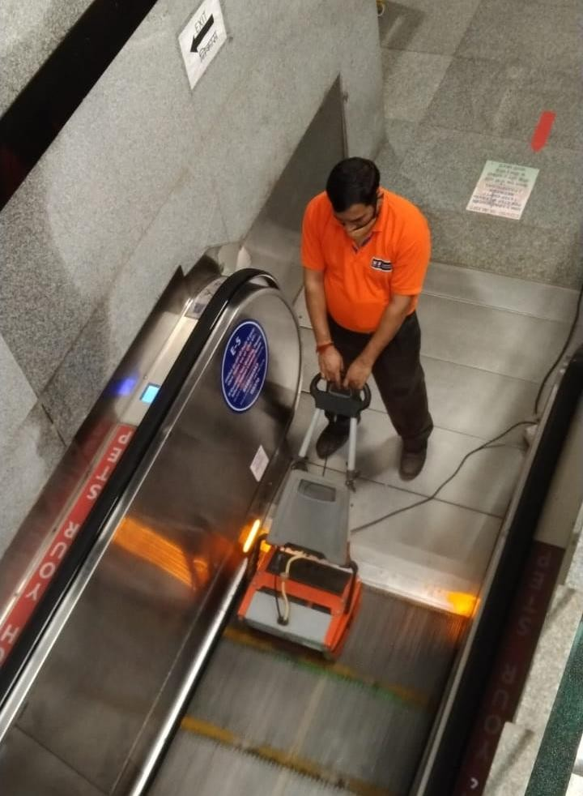
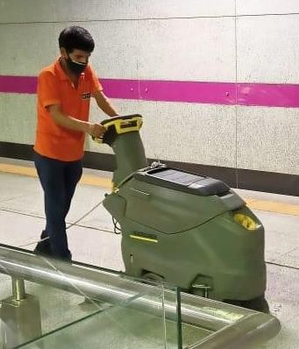
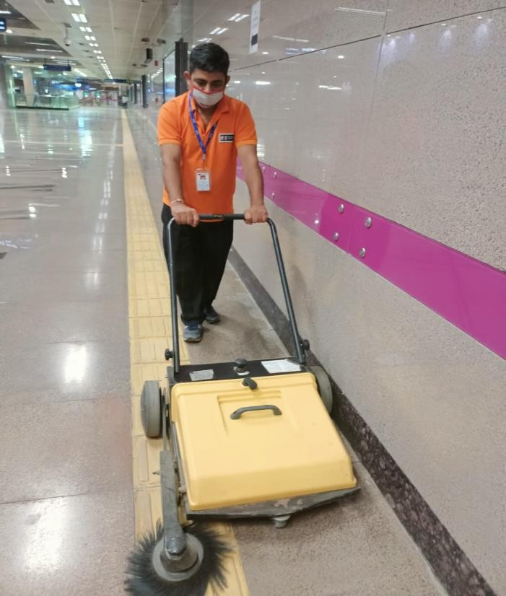
SNAP SHOTS
Machines from the best manufacturers like Diversey, Roots, Karcher or as demanded by the client.

Slide 23


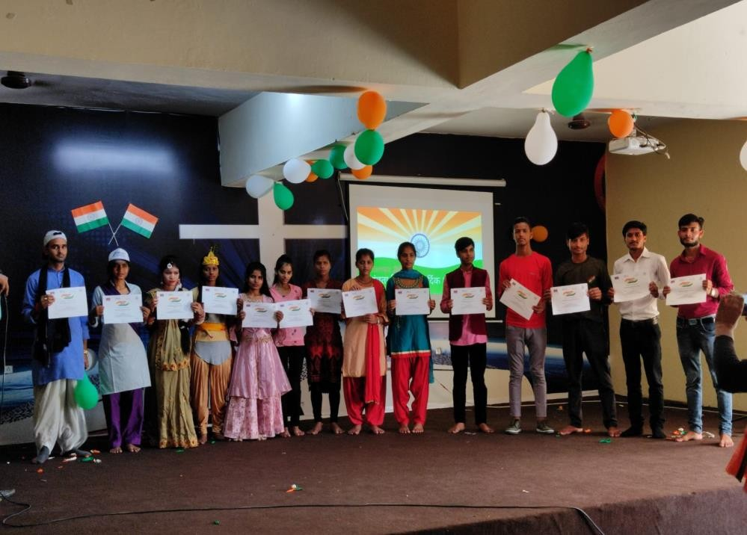
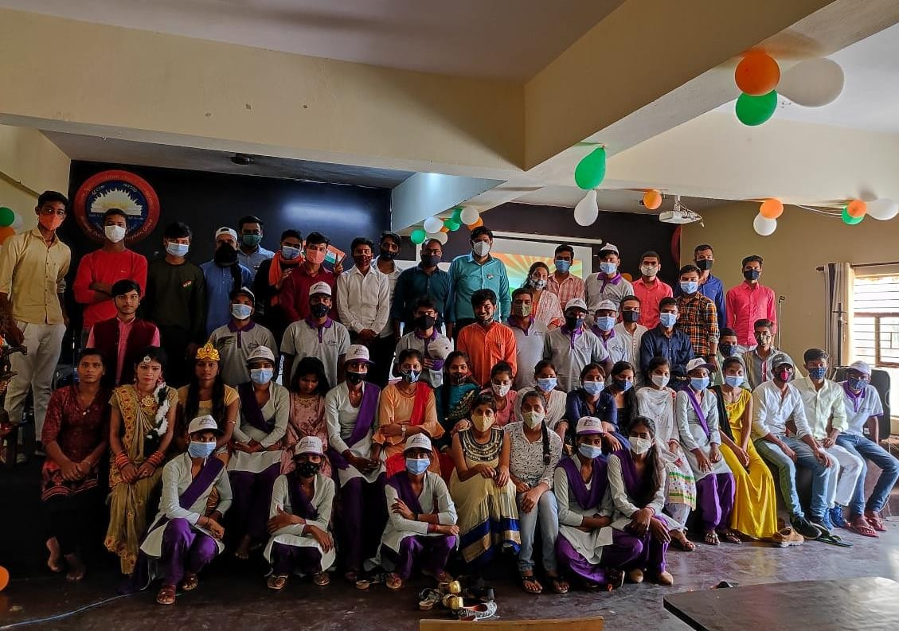
SNAPSHOT OF SKILL DEVELOPMENT
PROJECTS – Uttar Pradesh

Slide 24
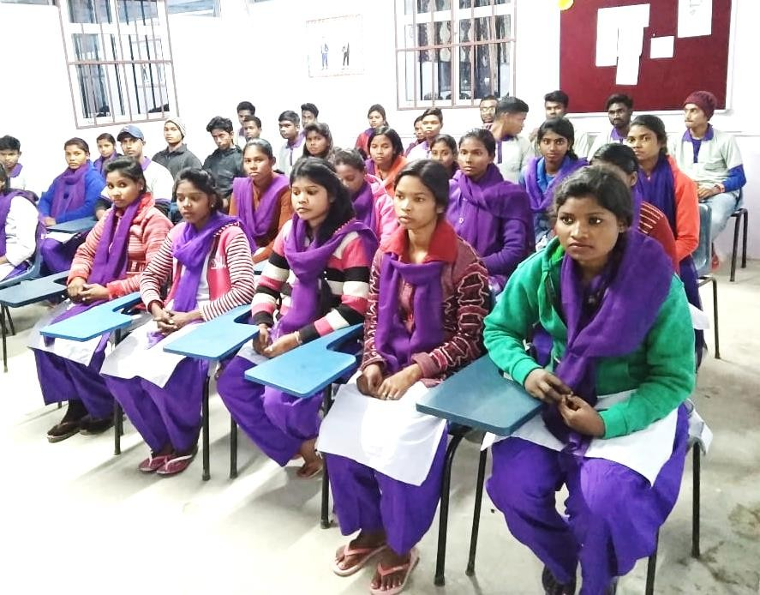
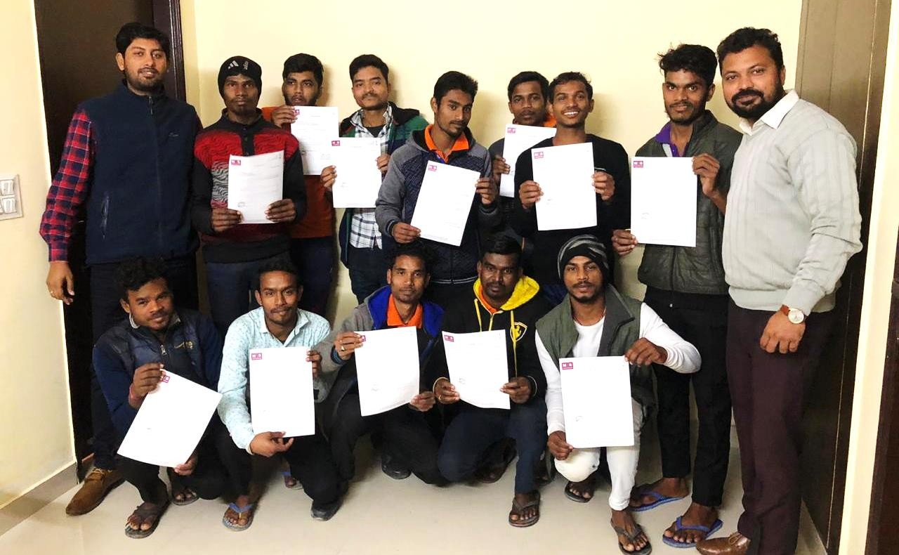
SNAPSHOT OF SKILL DEVELOPMENT
PROJECTS - Tripura

Slide 25
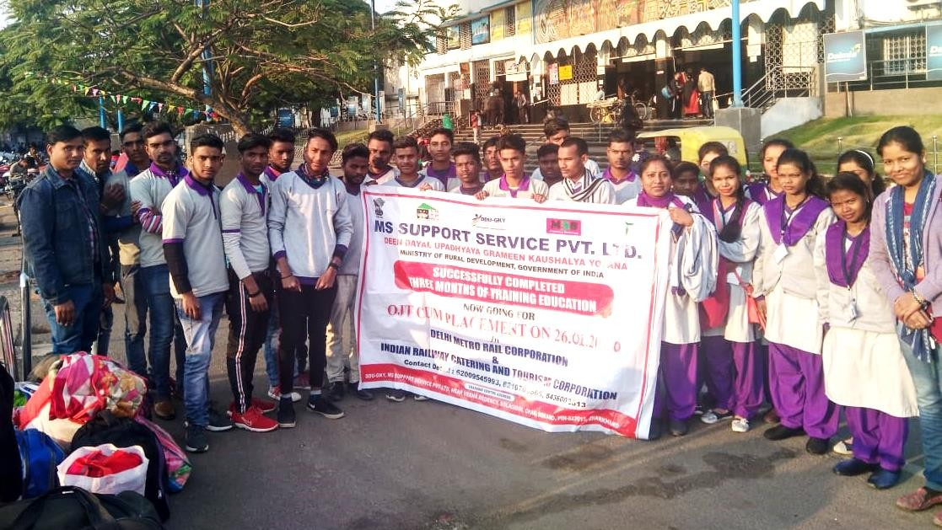
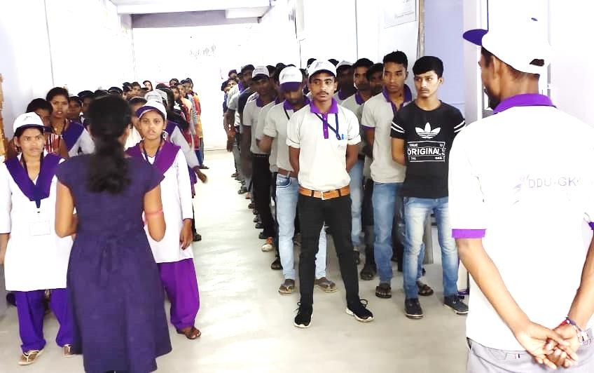
SNAPSHOT OF SKILL DEVELOPMENT
PROJECTS - Jharkhand

Slide 26
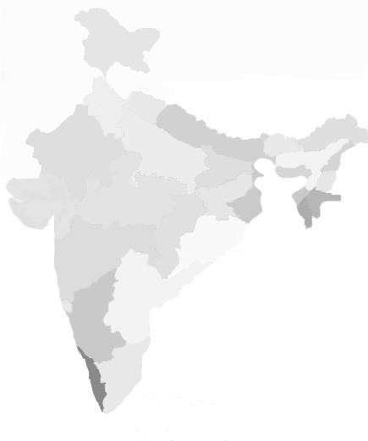
National Presence
Corporate Office:
Plot No. 378, MS Complex, Old Delhi Gurgaon Road Kapashera New Delhi, India
State Office: at all operational Locations

